Slide 1





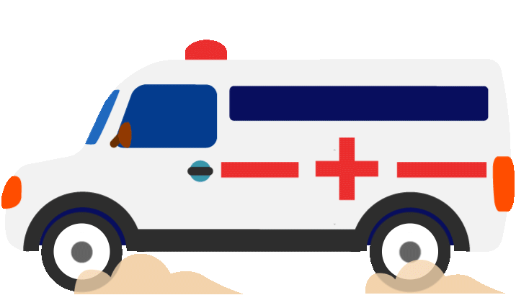

TITLE
ACCIDENT DETECTION AND RESCUE SYSTEM USING IOT

Slide 2



Topic Outline
proposed solution
1
Introduction
3
4
working
problem statement
2
5
conclusion

Slide 3

ABSTRACT
In today's world, as we know the frequency of road accidents has exponentially increased. Whenever we see the news or read newspaper, we find at least one case of road accident every day. Road accidents are a serious issue all over the world. Recent survey suggests that 650,000 accidents happen around the world on an average, out of which 140,000 occur in India. In every six minutes there is one death in India, due to road accidents. There is no system for quick support, identification and proclamation regarding an accident The aim is to detect an accident as soon as it occurs and to contact the emergency services and respective family members and friends so that proper action can be taken in quick time to avoid fatal loss. This system is implemented using the open source Internet of Things (IOT) platform.

Slide 4

Introduction
Automatic accident detection using smart device and alerting the rescue system and family
Road accidents and traffic congestion are major problems in India. And when a accident occurs in remote places it is impossible to identify and rescue them on time, so there is a need to introduce a system to detect the accident using smart sensor device and A main server unit houses having the database of all hospitals in the city. A GPS and GSM module in the concerned vehicle will send the location of the accident to the main server which will rush an ambulance from a nearest hospital to the accident spot..

Slide 5
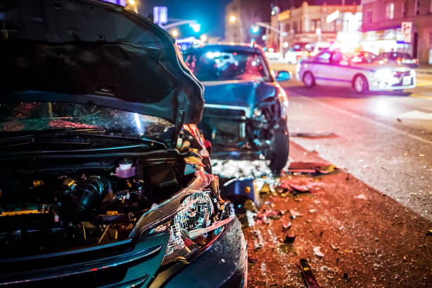
problem statement
currently there is no technology for automatic accident detection and automatic rescue system
when an accident happens it goes unnoticed for a long time before helps come in, which leads to death of victims.
And when a information send to hospital it is taking long time for the ambulance to reach the spot due to traffic, which leads to increase in mortality rate of victims.

Slide 6
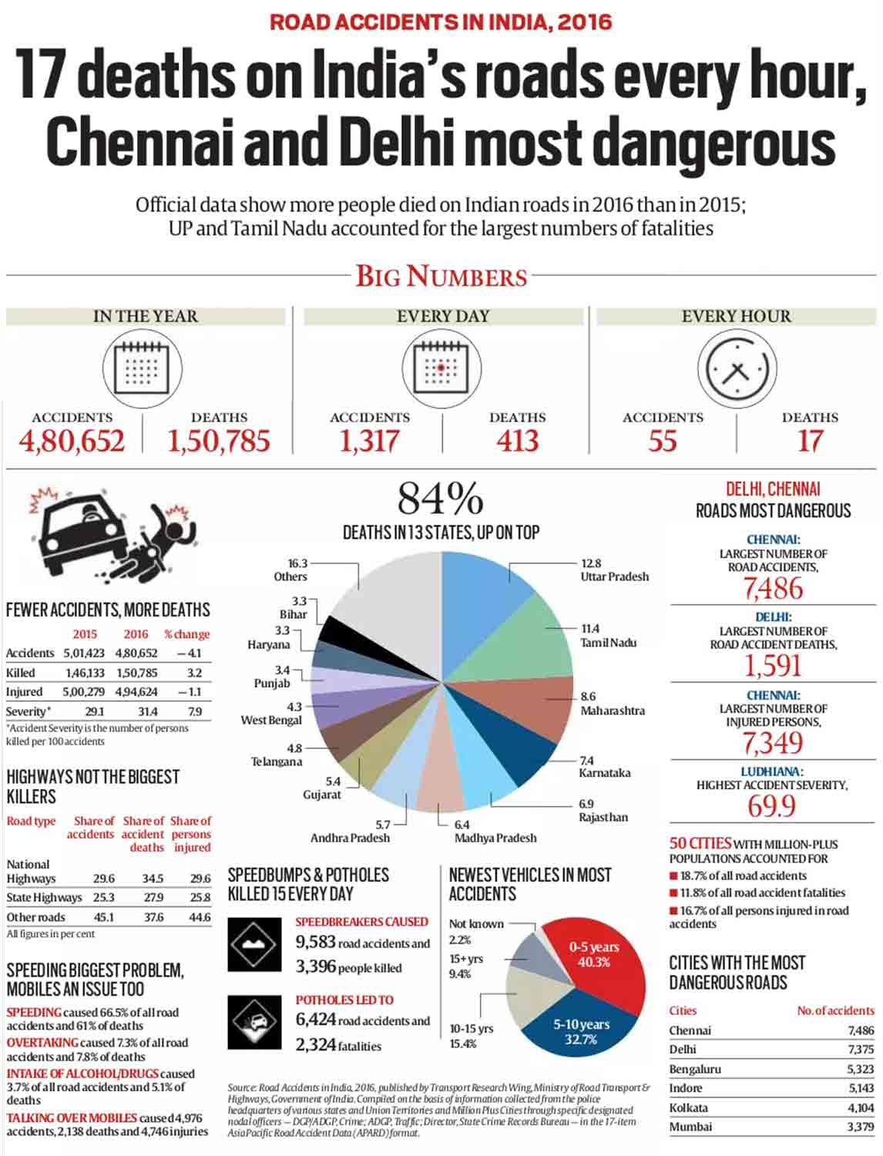
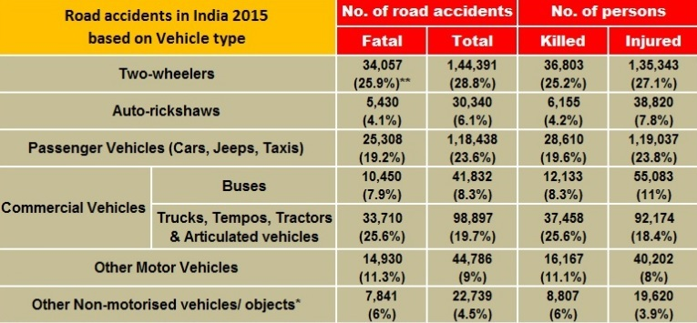
statistics
The first hour after an accident is called the Golden Hour - physicians say seriously injured car crash victims need to reach comprehensive medical care within 60 minutes to ensure a good chance of survival. At the accident scene, this scenario leaves about 12 minutes for rescuers to extricate the wounded and speed them toward the hospital.

Slide 7
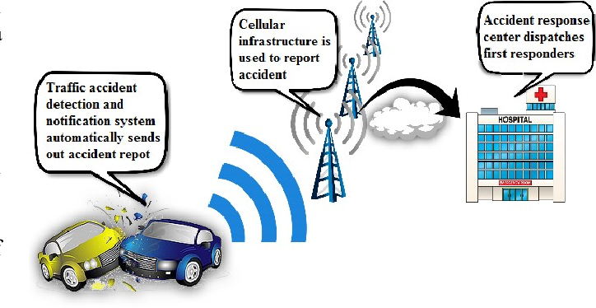
proposed solution
1
Accident detection
To Implement the new system in which there is an automatic detection of accident. A sensor, GPS, GSM unit fitted in the vehicle detects the accident and sends the accident location to a main server unit which houses the database of all the nearby hospitals.
2
Rescue system
An ambulance is rushed to the accident spot which carries the patient to the hospital and simultaneously monitors the vital parameters like temperature and pulse rate and conveys them to the concerned hospital. Along with this there would be control of traffic light signals in the path of the ambulance via RF communication to provide a clear path for the ambulance. This will minimize the time required by the ambulance to reach the hospital.

Slide 8
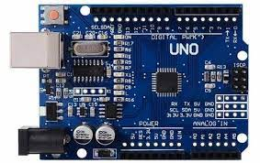
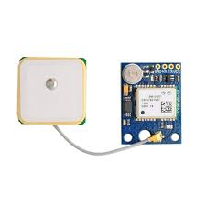
Components used
ARDUINO UNO
Arduino UNO is a microcontroller board based on the ATmega328P. It has 14 digital input/output pins (of which 6 can be used as PWM outputs), 6 analog inputs, a 16 MHz ceramic resonator, a USB connection, a power jack, an ICSP header and a reset button. It contains everything needed to support the microcontroller; simply connect it to a computer with a USB cable or power it with a AC-to-DC adapter or battery to get started.
GPS MODULE
Global Positioning System (GPS) is a satellite-based system that uses satellites and ground stations to measure and compute its position on Earth.
GPS receiver needs to receive data from at least 4 satellites for accuracy purpose. GPS receiver does not transmit any information to the satellites.

Slide 9
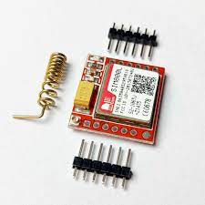
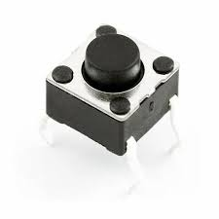
Components used
GSM MODULE
A GSM module or a GPRS module is a chip or circuit that will be used to establish communication between a mobile device or a computing machine and a GSM or GPRS system.
PUSH BUTTON
A push button switch is a mechanical device used to control an electrical circuit in which the operator manually presses a button to actuate an internal switching mechanism

Slide 10
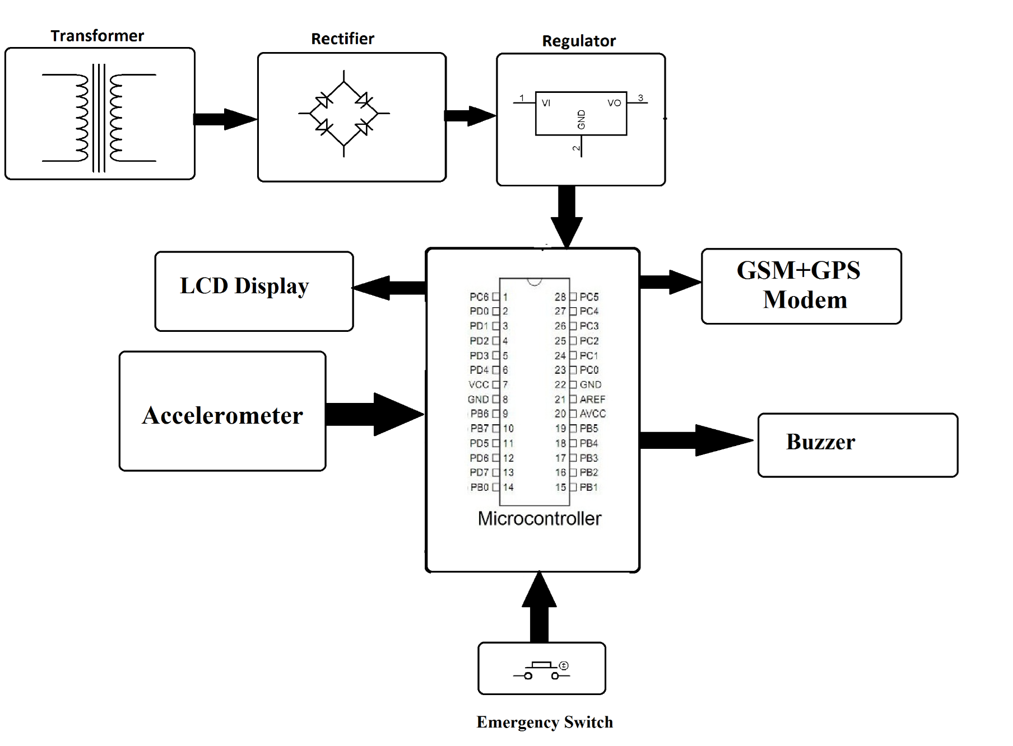
BLOCK DIAGRAM

Slide 11
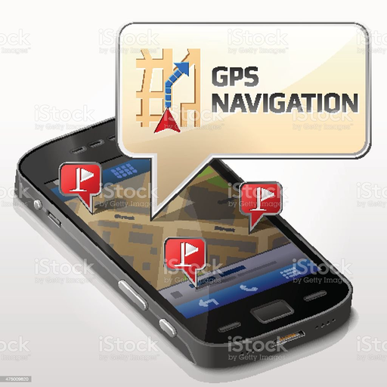
WORKING
Automatic accident detection using smart device and alerting the rescue system and family
It consists of microcontroller along with the accelerometer, GPS and GSM module and sensors to sense the accident and send information to main server.
the control unit will house all the database of all the nearest hospitals in order to send an ambulance to the accident spot.

Slide 12
WORKING
Automatic accident detection using smart device and alerting the rescue team and family
Whenever an accident happens the system will detect it and wait for the person response if it is a minor accident the person will push the button and when button is not pressed it is consider as a major accident and an alerting message is sent to ambulance and family members.
Ambulance collects the victim from the accident location and monitor continuously.

Slide 13
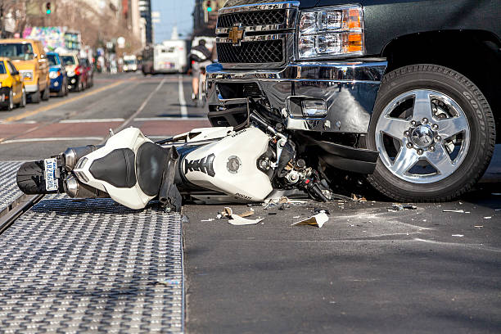
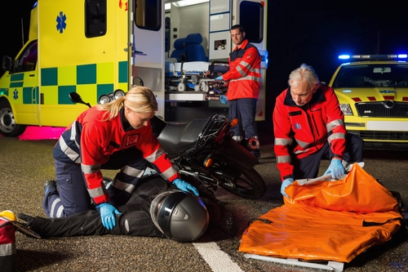
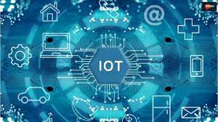

conclusion
Thus we developed a automated system to detect accident and to give information to ambulance, and the information is passed to the emergency numbers in contact list automatically A smart system in ambulance to avoid traffic which helps to reach faster to the accident spot which can save the lives of victims in golden hours.

Slide 14
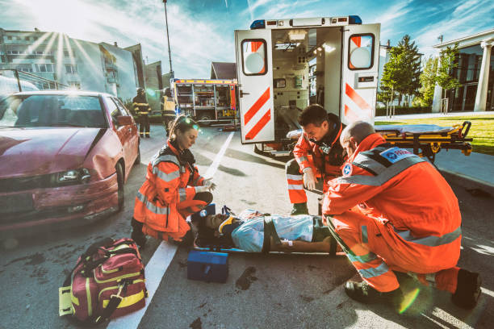

Thank you !
A GOLDEN SECOND CAN SAVE ONES GOLDEN LIFE !

